Slide 1

Reading book

Slide 2

Fishing

Slide 3
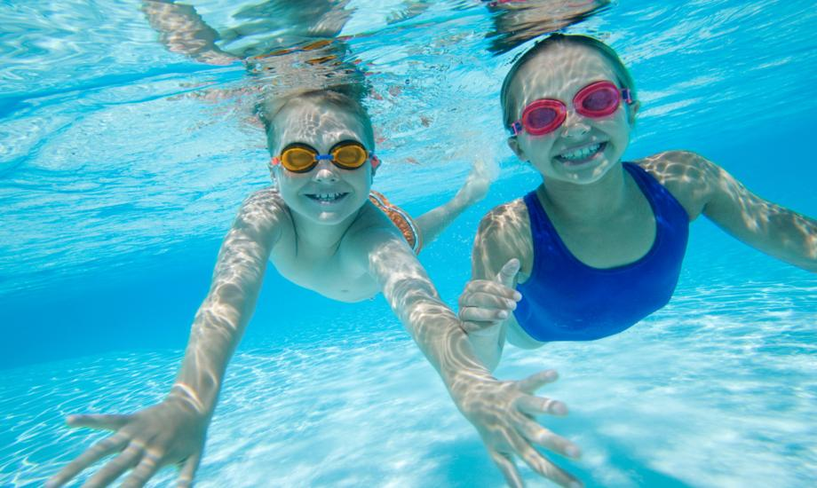
Swimming

Slide 4

Traveling

Slide 5
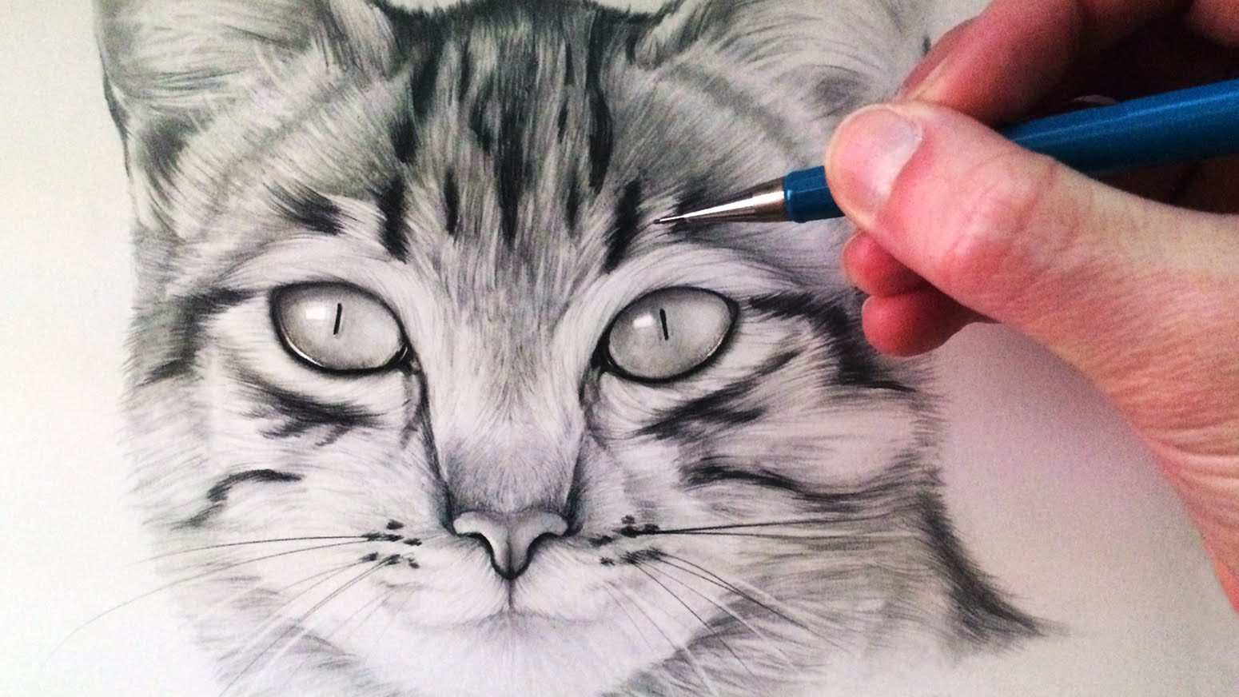
Drawing

Slide 6
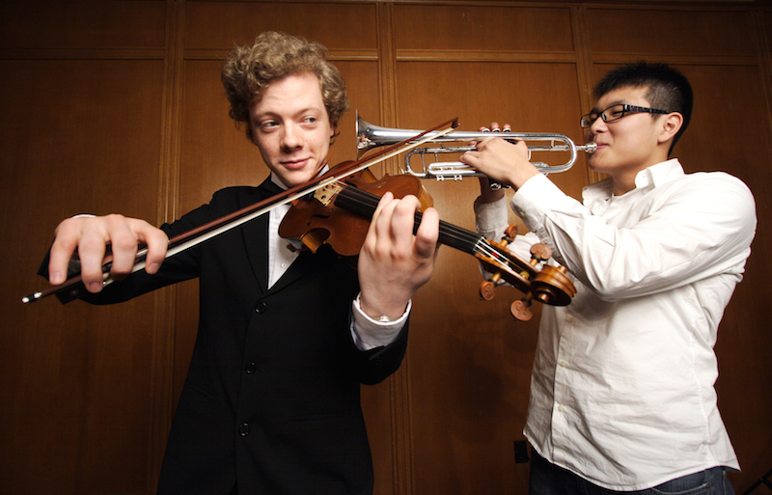
Playing an instrument

Slide 7
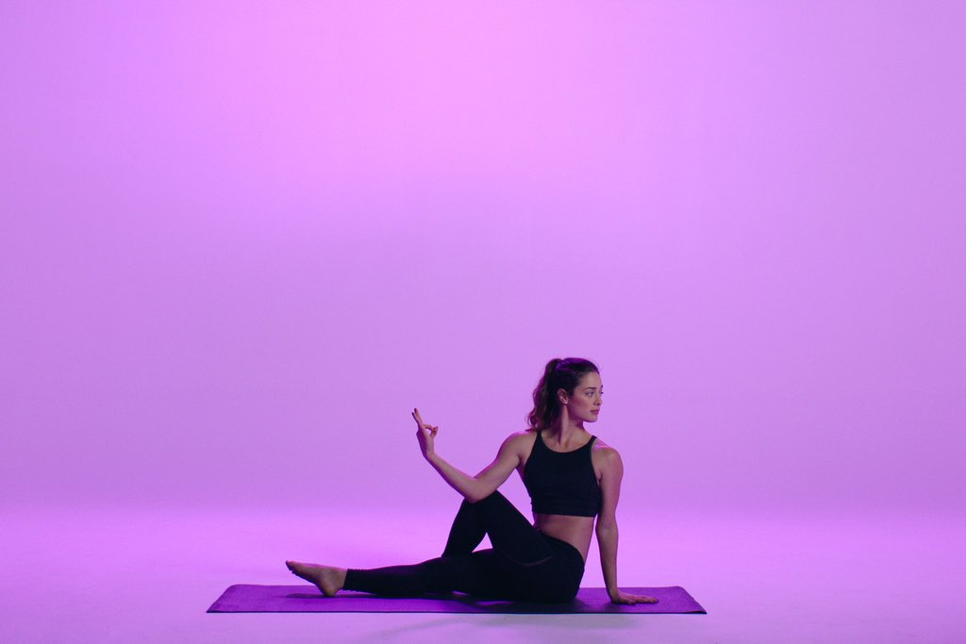
Yoga

Slide 8
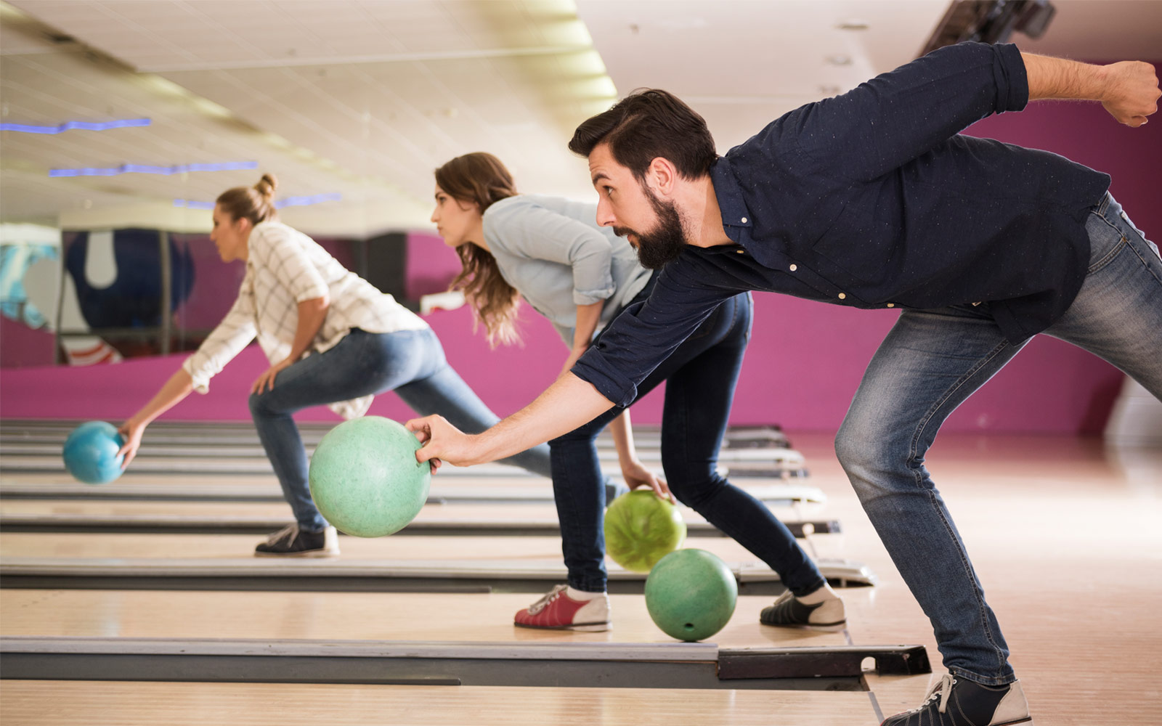
Bowling

Slide 9
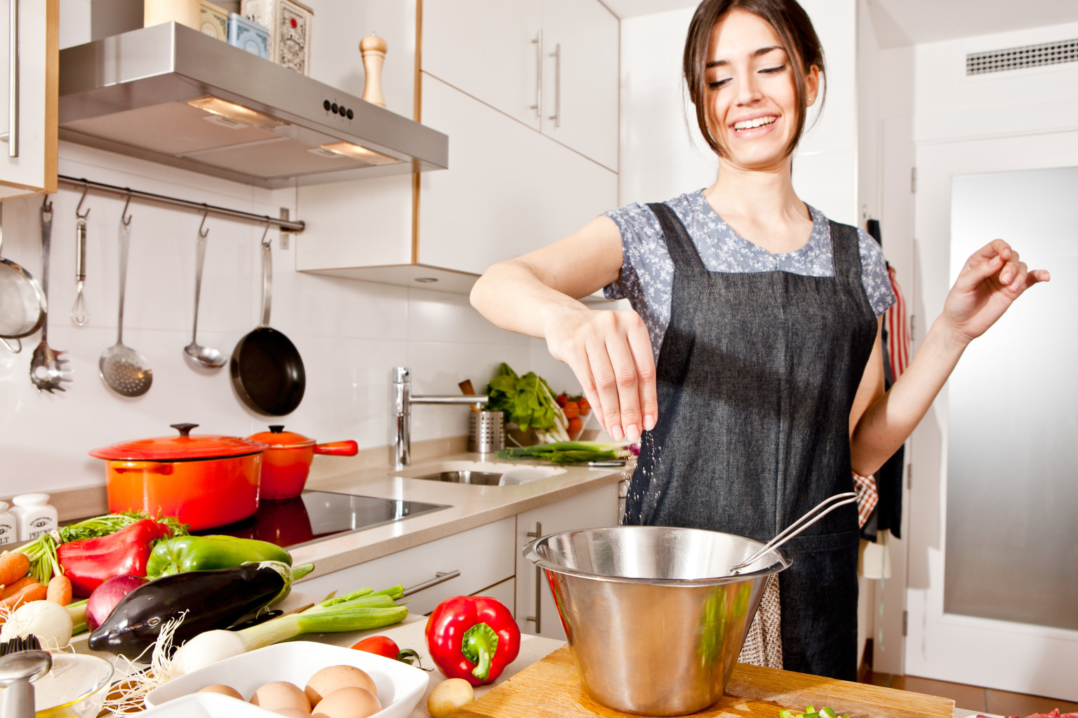
Cooking

Slide 10
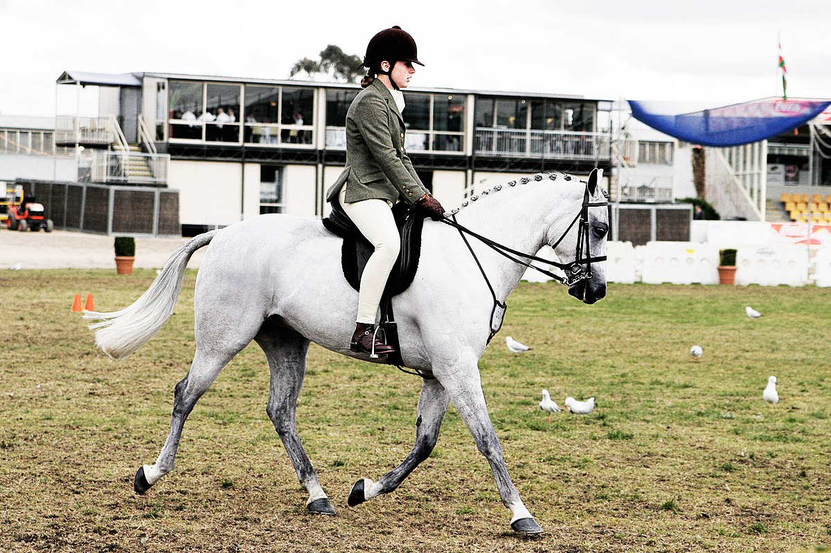
Horseback riding

Slide 11

Dancing

Slide 12

Watching TV

